Slide 1

SAI VIDYA INSTITUTE OF TECHNOLOGY
Department of Computer Science and Engineering
Rajanukunte, Bengaluru - 560064
Project Phase -1 Intermediate Seminar 2020-21
Traffic rule violation detection and reporting system
By
Rakesh M R 1VA17CS040
B G Vinayak 1VA17CS010
Under the guidance of
Prof. Santhosh Reddy P
Assistant Professor
Dept. of CSE

Slide 2
Introduction
The increasing number of cars in cities can cause high volume of traffic, and implies that traffic violations become more critical nowadays in India and also around the world. This causes severe destruction of property and more accidents that may endanger the lives of the people. To solve the alarming problem and prevent such unfathomable consequences, traffic violation detection systems are needed. For which the system enforces proper traffic regulations at all times, and apprehends those who do not comply.
A traffic violation detection system must be realized in real-time as the authorities track the roads all the time. Hence, traffic enforcers will not only be at ease in implementing safe roads accurately, but also efficiently; as the traffic detection system detects violations faster than humans. A user friendly graphical interface is associated with the system to make it simple for the user to operate the system, monitor traffic and take action against the violations of traffic rules.
Dept. of CSE, SVIT ‹#›

Slide 3
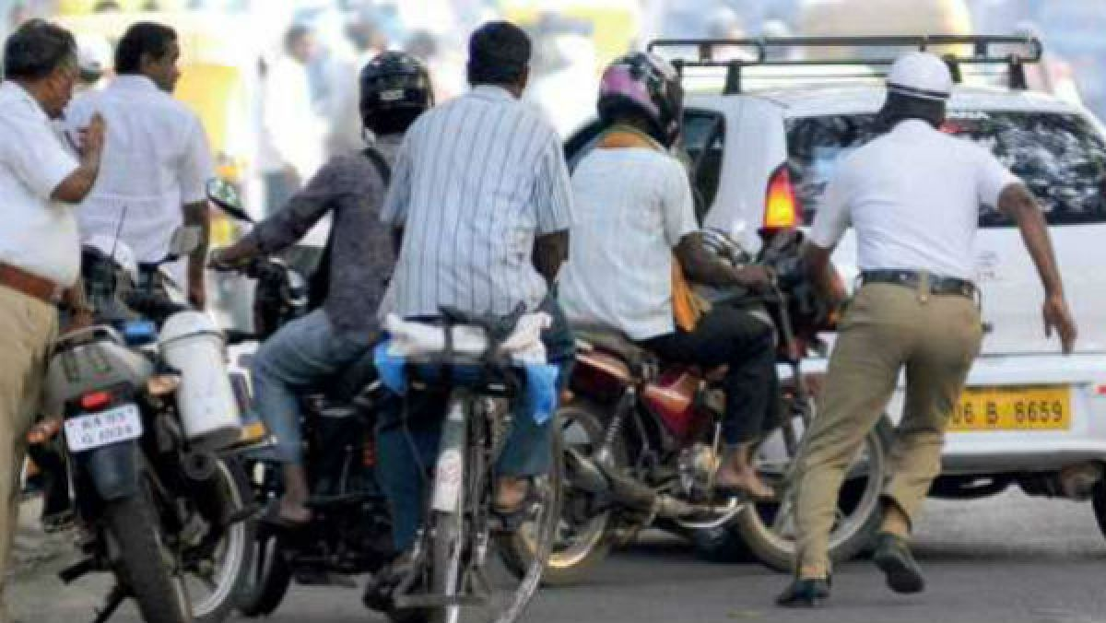
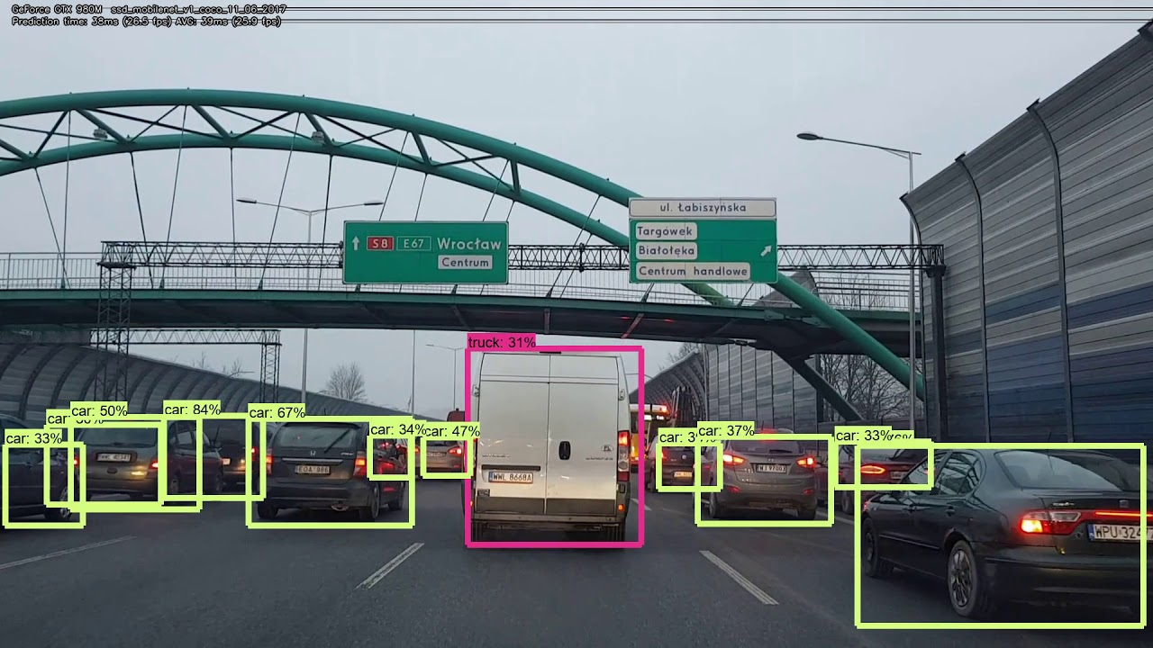
Problem Statement
To develop an efficient and accurate solution for automating the detection of violation of traffic rules and reporting the victim in a minimal amount of time.
Dept. of CSE, SVIT ‹#›

Slide 4
Literature Survey
Paper title | What it Does? | Limitations
Traffic Rules Violation Detection System | Signal violation detection Parking violation detection Direction violation detection | The system is able to process one data at a time Program runtime is slow Lack of number plate detection
Paper title | What it Does? | Limitations
Automatic Traffic Rule Violation Detection and Number Plate Recognition | Signal violation detection Reporting the victim | The system is able to process one data at a time Program runtime is slow Project is sensitive to vibration and fast changing targets due to the long shutter time
Dept. of CSE, SVIT ‹#›

Slide 5
System Requirement Specification
Software Requirements:
Operating System: Windows, Linux or Mac OS
Browsers: Chorme or Firefox or Edge
Front-End Design Tool: Figma
Programming Tool: Open CV, Python, Django, and a Database
Hardware Requirements:
High end Processor and GPUs
RAM: 8GB or Higher
Dept. of CSE, SVIT ‹#›

Slide 6
System Requirement Specification
Functional Requirements:
A computer with high speed processor specifications or GPU will increase the efficiency.
Creating an enhanced UI for faster and easy to use web application.
Nice GUI will increase the usability.
Dept. of CSE, SVIT ‹#›

Slide 7
System Requirement Specification
Non Functional Requirements:
Availability: Since it is a web application it will be available on all devicesct
Performance: efficient algorithms will increase the performance.
Maintainability: This application ensure high maintainability by receiving regular updates and bug fixes to ensure user friendliness and high compatibility.
Security: This application will not use or misuse the user information of any kind and will be maintained confidential.
Dept. of CSE, SVIT ‹#›

Slide 8
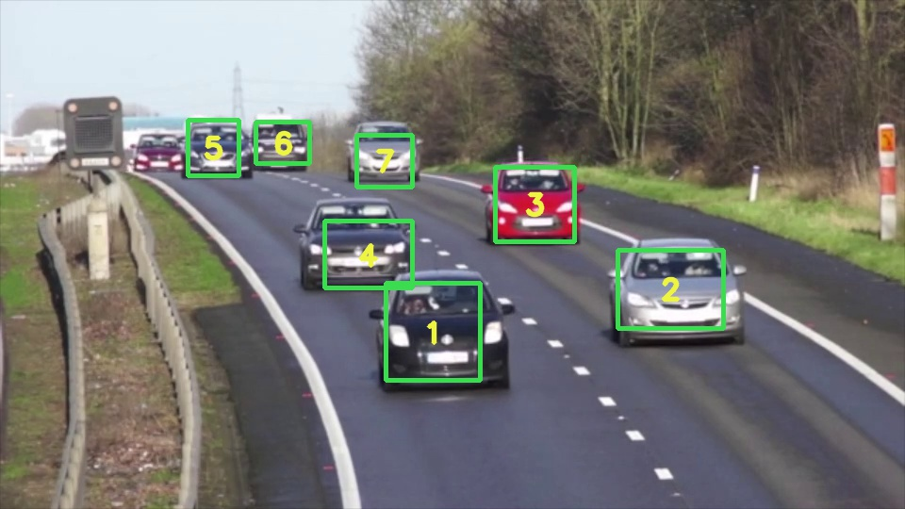
Conclusion
The Traffic Monitoring System is one of the effective tools for enforcement of traffic rules on Indian roads in a transparent manner. The system aims at harnessing strength of technology and minimise human intervention to bring about the speed and transparency in the whole process of traffic regulation.
Dept. of CSE, SVIT ‹#›

Slide 9
References
https://ieeexplore.ieee.org/document/8343528
http://www.jetir.org/papers/JETIR1703020.pdf
Mukremin Ozkul , Ilir Capuni (2018). ” Police-less multiparty traffic violation detection and reporting system with privacy preservation”, IET Intelligent Transport Systems, Vol. 12 No. 5, pp. 351-358.
Rhen Anjerome Bedruz, Aaron Christian P. Uy, Ana Riza Quiros, Robert Kerwin Billones, Edwin Sybingco, Argel Bandala, Elmer P. Dadios (2019). “A Robotic Model Approach of an Automated Traffic Violation Detection System with Apprehension” 2018 IEEE 10th International Conference on Humanoid, Nanotechnology, Information Technology,Communication and Control, Environment and Management (HNICEM), pp. 1-4.
SamirA.Elsagheer Mohamed (2019). “Automatic Traffic Violation Recording and Reporting System to Limit Traffic Accidents: Based on Vehicular Ad-hoc Networks (VANET)”. 2019 International Conference on Innovative Trends in Computer Engineering (ITCE), pp. 254-259.
Dept. of CSE, SVIT ‹#›

